Slide 1
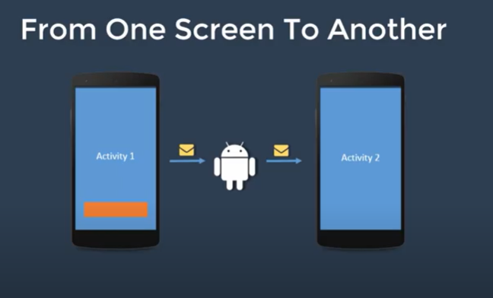
Intents
Android uses Intent for communicating between the components of an Application and also from one application to another application.
Intent are the objects which is used in android for passing the information among Activities in an Application and also passing information from one app to another.
Intent facilitate to redirect one activity to another activity on occurrence of any event.

Slide 2
Intents
Intent are of two types: Explicit Intent and Implicit Intent.
Explicit Intent
Explicit Intents are used to connect the application internally.
In Explicit we use the name of component which will be affected by Intent.
For Example: If we know class name then we can navigate the app from One Activity to another activity using Intent.
Explicit Intent work internally within an application to perform navigation and data transfer.
Example :
Intent intent = new Intent(getApplicationContext(), SecondActivity.class);
startActivity(intent);

Slide 3
Intents
Implicit Intent
In Implicit Intents we just specify the Action which has to be performed.
This action is handled by the component of another application.
Unlike Explicit Intent we do not use any class name to pass through Intent().
The basic example of implicit Intent is to open any web page
Example to open a website using intent in current application.
Intent intentObj = new Intent(Intent.ACTION_VIEW);
intentObj.setData(Uri.parse("https://www.google.com"));
startActivity(intentObj);

Slide 4
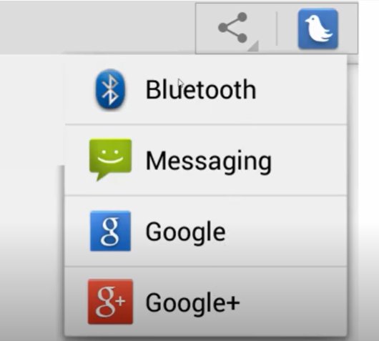
Intents

Slide 5
Android – Application Components
Application components are the essential building blocks of an Android application.
Each component is an entry point through which the system or a user can enter your app. Some components depend on others.
There are four different types of app components:
Activities
Services
Broadcast receivers
Content providers

Slide 6
Android – Application Components
Activities
An activity represents a single screen with a user interface,in-short Activity performs actions on the screen.
For example, an email application might have one activity that shows a list of new emails, another activity to compose an email, and another activity for reading emails.
If an application has more than one activity, then one of them should be marked as the activity that is presented when the application is launched..

Slide 7
Android – Application Components
Services
A service is a general-purpose entry point for keeping an app running in the background
It is a component that runs in the background to perform long-running operations or to perform work for remote processes.
A service does not provide a user interface.
For example, a service might play music in the background while the user is in a different app, or it might fetch data over the network without blocking user interaction with an activity.

Slide 8
Android – Application Components
Broadcast Receivers
Broadcast Receivers simply respond to broadcast messages from other applications or from the system.
For example, applications can also initiate broadcasts to let other applications know that some data has been downloaded to the device and is available for them to use.

Slide 9
Android – Application Components
Content Providers
A content provider component supplies data from one application to others on request. The data may be stored in the file system, the database or somewhere else entirely.

Slide 10
Intents
Android uses Intents for facilitating communication between its components like Activities, Services and Broadcast Receivers.
Intent for an Activity:
Every screen in Android application represents an activity. To start a new activity you need to pass an Intent object to startActivity() method. This Intent object helps to start a new activity and passing data to the second activity.
Intent for Services:
Services work in background of an Android application and it does not require any user Interface. Intents could be used to start a Service that performs one-time task(for example: Downloading some file) or for starting a Service you need to pass Intent to startService() method.
Intent for Broadcast Receivers:
There are various message that an app receives, these messages are called as Broadcast Receivers. (For example, a broadcast message could be initiated to intimate that the file downloading is completed and ready to use). Android system initiates some broadcast message on several events, such as System Reboot, Low Battery warning message etc.

Slide 11
Intents
Importance of using Intents in Android Applications:
Whenever you need to navigate to another activity of your app or you need to send some information to next activity then we can always prefer use Intents.
Intents are really easy to handle and it facilitates communication of components and activities of your application. Moreover you can communicate to another application and send some data to another application using Intents.

Slide 12
Intents

Slide 13
Intents
<Button
android:id="@+id/implicit"
android:layout_width="wrap_content"
android:layout_height="wrap_content"
android:layout_marginStart="148dp"
android:layout_marginLeft="148dp"
android:layout_marginTop="152dp"
android:text="Implicit"
app:layout_constraintStart_toStartOf="parent"
app:layout_constraintTop_toTopOf="parent" />
<Button
android:id="@+id/explicit"
android:layout_width="wrap_content"
android:layout_height="wrap_content"
android:layout_marginTop="72dp"
android:layout_marginEnd="172dp"
android:layout_marginRight="172dp"
android:text="Explicit"
app:layout_constraintEnd_toEndOf="parent"
app:layout_constraintTop_toBottomOf="@+id/button" />

Slide 14
Intents
<TextView
android:id="@+id/textView"
android:layout_width="wrap_content"
android:layout_height="wrap_content"
android:layout_marginTop="224dp"
android:textAppearance="?android:attr/textAppearanceLarge"
android:text="Second Activity"
app:layout_constraintEnd_toEndOf="parent"
app:layout_constraintHorizontal_bias="0.538"
app:layout_constraintStart_toStartOf="parent"
app:layout_constraintTop_toTopOf="parent" />

Slide 15
Intents
public class MainActivity extends AppCompatActivity {
@Override
protected void onCreate(Bundle savedInstanceState) {
super.onCreate(savedInstanceState);
setContentView(R.layout.activity_main);
Button explicit_btn = findViewById(R.id.explicit);
Button implicit_btn = findViewById(R.id.implicit);
//implement Onclick event for Explicit Intent
explicit_btn.setOnClickListener(new View.OnClickListener() {
@Override
public void onClick(View v) {
Intent intent = new Intent(this, MainActivity2.class);
startActivity(intent);
}
});

Slide 16
Intents
//implement onClick event for Implicit Intent
implicit_btn.setOnClickListener(new View.OnClickListener() {
@Override
public void onClick(View v) {
Intent intent = new Intent(Intent.ACTION_VIEW);
intent.setData(Uri.parse("https://www.google.com"));
startActivity(intent);
}
});
}
}

Slide 17
Intents
public class MainActivity2 extends AppCompatActivity {
@Override
protected void onCreate(Bundle savedInstanceState) {
super.onCreate(savedInstanceState);
setContentView(R.layout.activity_main2);
Toast.makeText(getApplicationContext(), "We are moved to second Activity", Toast.LENGTH_LONG).show();
}
}

Slide 18
Passing data between Activities using Intent in Android
If you need to pass some information or data to the new Activity you are calling, you can do this by calling putExtra() method before the startActivity() method.
This method accepts key-value pair as its parameter.
i.putExtra("key1", "I am value1");
i.putExtra("key2", "I am value2");
startActivity(i);

Slide 19
Passing data between Activities using Intent in Android
Note: To receive the data in the new Activity and use it accordingly, you need to call the getIntent() method and then getStringExtra() method in the java class of the Activity you want to open through explicit intent. getStringExtra() method takes the key as the parameter.
String a = getIntent().getStringExtra("key1");
Doing this, stores the value stored at key1 into the string variable a.

Slide 20
Passing data between Activities using Intent in Android
How we pass data through Intent?
To pass the data through Intent we will use putExtra() method and in parameter, we will use Key-Value Pair.
To pass the data through Intent we will use putExtra() method and in parameter, we will use Key-Value Pair.
Now, where we have to mention putExtra() method?
We have to add putExtra() method in onClick()

Slide 21
Passing data between Activities using Intent in Android
EditText edittextfullname,edittextusername;
Button loginbutton;
@Override
protected void onCreate(Bundle savedInstanceState) {
super.onCreate(savedInstanceState);
setContentView(R.layout.activity_login);
edittextfullname=findViewById(R.id.editTextFullName);
edittextusername=findViewById(R.id.editTextUserName);
loginbutton=findViewById(R.id.LoginButton);

Slide 22
Passing data between Activities using Intent in Android
EditText edittextfullname,edittextusername;
Button loginbutton;
@Override
protected void onCreate(Bundle savedInstanceState) {
super.onCreate(savedInstanceState);
setContentView(R.layout.activity_login);
edittextfullname=findViewById(R.id.editTextFullName);
edittextusername=findViewById(R.id.editTextUserName);
loginbutton=findViewById(R.id.LoginButton);

Slide 23
Passing data between Activities using Intent in Android
String fullName = edittextfullname.getText().toString();
edittextfullname.getText().toString() : This means when the user enters the name in edittextfullname we get the entered value from this method with the help of getText() and then the value or name is converted in to string by using toString().
putExtra() : This method sends the data to another activity and in parameter, we have to pass key-value pair.

Slide 24
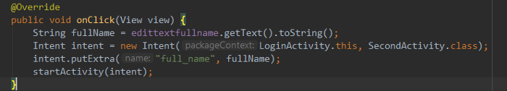
Passing data between Activities using Intent in Android

Slide 25
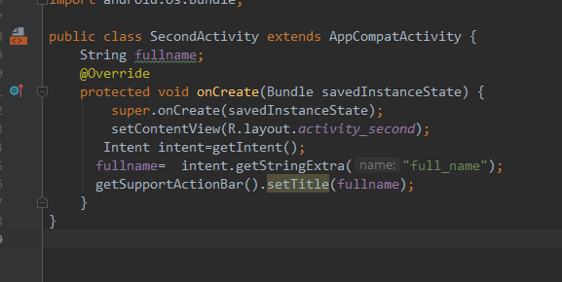
Passing data between Activities using Intent in Android

Slide 26
Passing data between Activities using Intent in Android
String fullname : We have declared a variable of String type.
Intent intent=getIntent() : It gets the Intent from the LoginActivity.
fullname= intent.getStringExtra(“full_name”) : This line gets the string form LoginActivity and in parameter, we have to pass the key which we have mentioned in LoginActivity.
getSupportActionBar().setTitle(fullname): This line sets the fullname in ActionBar as a Title.

Slide 27
Passing data between Activities using Intent in Android
Create an android application for authentication process. First activity should accept the
user email address and pass the email id to the second activity. In the second activity it
should show the user email id and ask for the password.

